Slide 1
“SYNTHESIZING AND IMITATING HANDWRITING USING DEEP RECURRENT NEURAL NETWORKS AND MIXTURE DENSITY NETWORKS” BY K. KUMAR, HARISH KANDALA AND DR. N. REDDY
PRESENTATION BY DARSHAN PATEL
FORDHAM UNIVERSITY GABELLI SCHOOL OF BUSINESS
ISGB 799Z – DEEP MACHINE LEARNING - SPRING 2019

Slide 2
Research Question
Learn to create handwritten text using a certain handwriting style
A step further from handwriting recognition, a common question in deep learning

Slide 3
Significance
Generating personalized handwritten documents
Editing a handwritten document on a device
Identify forgery in important documents

Slide 4
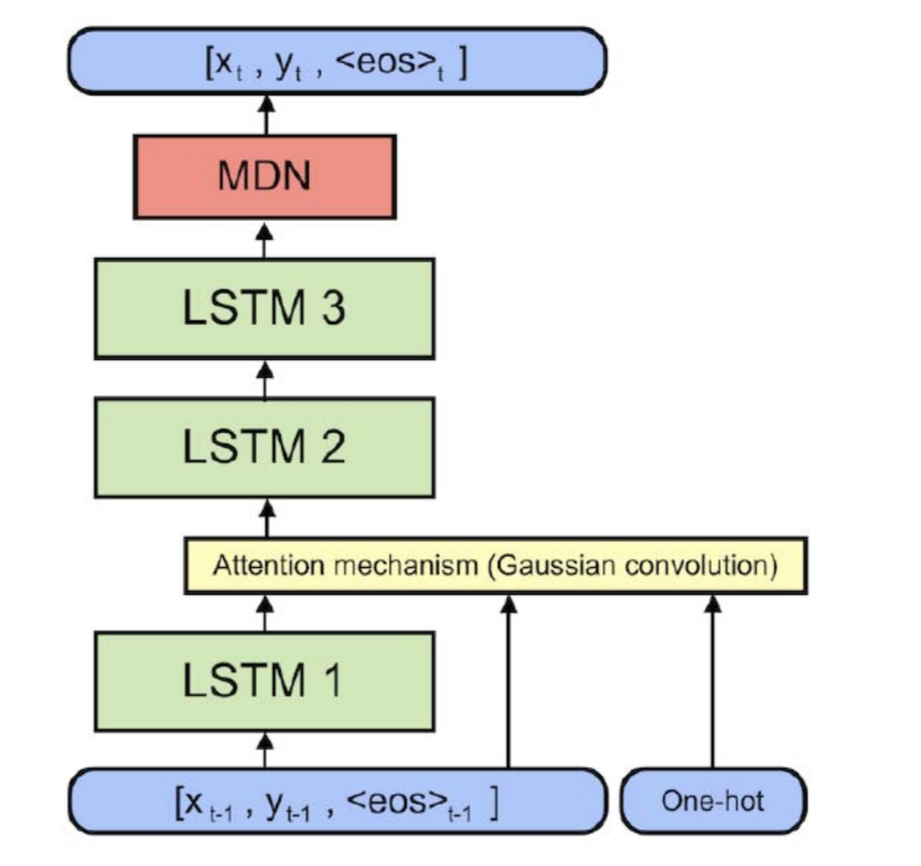
Methodology
Handwritten text from 223 different writers
5356 lines of text for training set, ~1.5k for two validation sets and 4859 for test set
Data is fed into three stacked LSTM cells that form a deep recurrent neural network along with an attention mechanism and mixture density network
Two methods to imitate any handwriting style: restraining the top LSTM cell, using GAN architecture

Slide 5
Method 1: Restraining the top LSTM CELl
Use the same architecture and create multiple copies of the network for each handwriting style
A text sample is fed into the network
Trained parameters get copied
The copied network gets re-trained using only the top LSTM layer (time saving)
After retraining, use model to generate handwritten text with a certain style
Prime the training data so the style is continued

Slide 6
Method 2: Using gAN architecture
Using generative adversarial networks, train 2 models
the generative model will create data – current mechanism
the discriminative model will evaluate whether the data is likely to come from the training data - classifier
The use of the discriminative model can help identify forgery
When retraining, the discriminator compares the handwriting style to the original style, thus learning the handwriting style in a few training steps
**Researchers did not use this method**

Slide 7
Difficulties and Conclusion
Trained the model on AWS GPU instances (~1 day)
Model has many hyperparameters (3 layers)
researchers spent days tweaking them
Problem with data, not hyperparameters
Amount of data is too low, noisy results
Model is trained via resampling to increase size of data
An API was made to test the model by taking in a text, generating n samples using a handwriting style

Slide 8
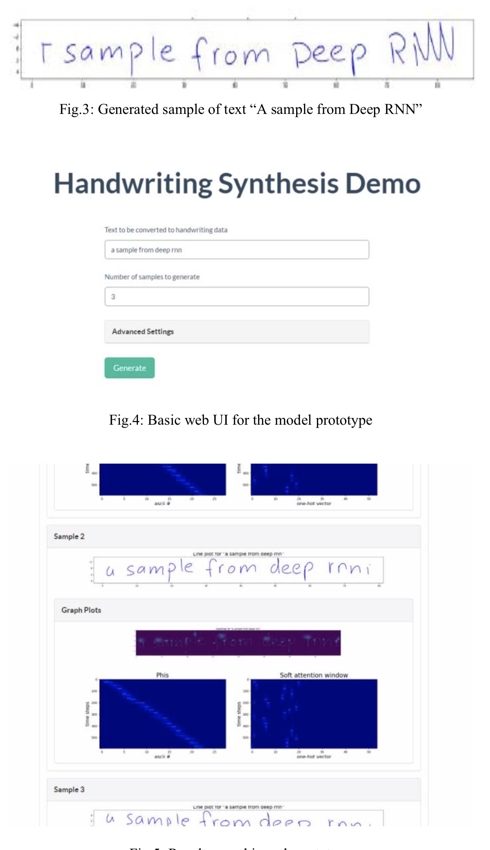
Snapshots from WEB api

Slide 9
Design Limitations and implications
No sense of performance metric - can only determine how well the generated data Is to the original style visually
Results depend on fine tuning hyperparameters
Longer strings cannot be generated due to LSTMs limits and needing more data
If RNNs are advanced in the future, it could mean using less training data to help learning handwriting style
Method is not limited to handwritten data but also any sequential data like in economics or DNA synthesis
Model can be applied in more useful real-time applications like for forgery

